Slide 1

Master n8n and WordPress Integration
Module - Zapier Advanced

Slide 2
Course Content
Week | Content | Activities
Week 1 | Course Outline Module 1: WordPress (Create a Business Site) | Hands-on Exercises Open discussion
Week 2 | Module 2: Introduction to n8n (Create the Products) | Hands-on Exercises Open discussion
Week 3 | Module 3 n8n – Advanced (Monitor Sales) | Hands-on Exercises Open discussion
Weed 4 | Module 4 8n8 – Fix Bugs / Maintenance (Improve the Products) | Hands-on Exercises Open discussion
Week 5 | Module 5 Creating a Video (Marketing Campaign) Module 6 Overview and Conclusion | Hands-on Exercises Open discussion

Slide 3


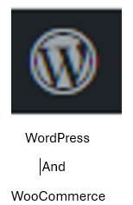





Integration
Overview
Gmail
Forms
Google
Sheets

Slide 4

What You Have is a Complete Framework
Business set up on WordPress
Developed Product with n8n
  AI Newsfeed Agent– Free Trial
  AI Newsfeed Agent - Subscription
Monitor Sales
Debug the Products
Testing
Video campaign for marketing purposes
Note: The workflows can easily be duplicated to create new products in n8n

Slide 5

Feedback Poll

Slide 6


