Slide 1

Master n8n and WordPress Integration
Module 5 - Creating a Video (Marketing Campaign)

Slide 2
Course Content
Week | Content | Activities
Week 1 | Course Outline Module 1: WordPress (Create a Business Site) | Hands-on Exercises Open discussion
Week 2 | Module 2: Introduction to n8n (Create the Products) | Hands-on Exercises Open discussion
Week 3 | Module 3 n8n – Advanced (Monitor Sales) | Hands-on Exercises Open discussion
Weed 4 | Module 4 8n8 – Fix Bugs / Maintenance (Improve the Products) | Hands-on Exercises Open discussion
Week 5 | Module 5 Creating a Video (Marketing Campaign) Module 6 Overview and Conclusion | Hands-on Exercises Open discussion

Slide 3

Agenda
Set up invideo
  Create a video to advertise your new product
  Refer the viewers to your link to WordPress site ( 7 day free)
  Edit the video
Set up YouTube account
  Create a channel
  Upload a video
  Copy description from invideo

Slide 4

Set Up an InVideo Free Trial
Visit the InVideo Website
  Go to https://invideo.io in your browser
Click on “Sign Up”
  You’ll find this at the top right of the homepage
Create an Account
  You can sign up using:
    Your email address, or
    Your Google or Facebook account (for quick access)

Slide 5
Set Up an Invideo Free Trial (Continued)
6. Understand Free Plan Limitations
  Exports have a watermark
  Access to standard media only (not premium)
7. Upgrade Option
  If you enjoy using InVideo, you can upgrade later to remove watermarks and access premium features.

Slide 6
Set Up an Invideo Free Trial (Continued)
4. Choose the Free Plan
  Invideo offers a free plan with limited features.
  You don’t need to enter credit card details to get started.
5. Explore the Dashboard
  Once signed up, you’ll land on the dashboard where you can:
    Choose from templates
    Start a blank project
    Use text-to-video tools

Slide 7
Create a Video
Indicate that you have a new service called AI Newsfeed and you want to create a video to announce it and indicate that you have a 7 day free trial. Ask for a call to action to try the 7 day free trial . Indicate that you will include a link in the video description.
When it is done, make some changes by giving the tool text instructions. (change to a female or male voice )
Hit the Edit button. Make changes to the script to introduce your channel and who you are. (Save)
Hit the Edit button again and try changing some of the images.
Download the video

Slide 8

Create a YouTube Account
1. Create a Google Account
YouTube is owned by Google, so you need a Google account.
Visit https://accounts.google.com
Click “Create account” and follow the instructions.
2. Go to YouTube
Visit https://www.youtube.com
Sign in with your Google account (top right corner).

Slide 9
Create a YouTube Channel
3. Create Your Channel
Click on your profile icon (top right).
Select “Create a channel”.
Enter a name for your channel.
Upload a profile picture (optional but recommended).
Click “Create Channel”.

Slide 10
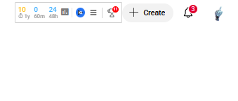
Upload Your Video
4. Upload Your First Video
Click the camera icon with a + (Create) at the top.
Select “Upload video” and follow the steps.
Copy the description from Invideo at the bottom of the video
Add the link to your Podia website and your product sales page
Go to the buttom of the page and click More… then add some tags

Slide 11
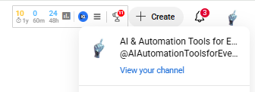
For Your Links to Work You will Need to Apply for
Advanced Options
1. Click On Your Logo at the top right
  Click on View Your Channel
2. Access Channel Settings
  On the left sidebar, click on "Settings" (gear icon).
  Select "Channel" and then the "Feature eligibility" tab.

Slide 12
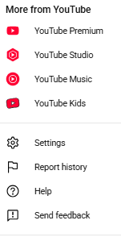

For Your Links to Work You will Need to Apply for
Advanced Options
3. Verify Your Account
To unlock advanced features, you must verify your identity:
Under "Intermediate features", click "Verify phone number".
Choose your country and method (text or voice call).
Enter your phone number and the code you receive.

Slide 13

For Your Links to Work You will Need to Apply for
Advanced Options
4. Once verified, you unlock:
  Custom thumbnails
  Longer video uploads (over 15 minutes)
  Live streaming
  Content ID appeals
5. Wait for Approval
  Most features are enabled instantly after phone verification.
  Some (like live streaming) may take up to 24 hours.

Slide 14
For Your Links to Work in the Video Description, You Need to Apply for Advanced Options
: Explore Advanced Features
  Return to YouTube Studio → Settings → Channel → Feature Eligibility
  You can apply for Advanced Options (like monetization, external links in cards) once your channel builds trust over time.
  However, if you apply immediately, you will get it in about 24 hours. After a few months, you will lose it. However, your links in the video description will continue to work.

Slide 15


