Slide 1

Master n8n and Wordpress Integration
Module 4 - 8n8 – Fix Bugs / Maintenance (Improve the Products)

Slide 2
Course Content
Week | Content | Activities
Week 1 | Course Outline Module 1: WordPress (Create a Business Site) | Hands-on Exercises Open discussion
Week 2 | Module 2: Introduction to n8n (Create the Products) | Hands-on Exercises Open discussion
Week 3 | Module 3 n8n – Advanced (Monitor Sales) | Hands-on Exercises Open discussion
Weed 4 | Module 4 8n8 – Fix Bugs / Maintenance (Improve the Products) | Hands-on Exercises Open discussion
Week 5 | Module 5 Creating a Video (Marketing Campaign) Module 6 Overview and Conclusion | Hands-on Exercises Open discussion

Slide 3

Agenda
Update the Product
  Check if someone entered the wrong email address
  Check if the End Date has passed in case someone registers a second time for the free trial. WooCommerce will allow this. But you need to redirect the users to the paid product
Test – Test - Test

Slide 4
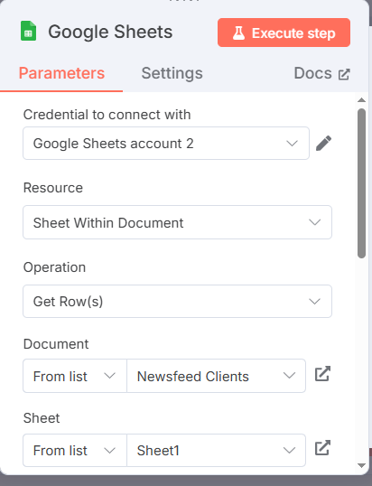
Open Your First Workflow - AI News Feed Agent
Check if the client’s email exists
Add a Google Sheet node with a Get Row(s) operation to see if the email exists
Add an If node to verify email exist.
  If the row exist, proceed to the next step
  If not send an email to the client to advise them that this email is not the email used during registration.
    This will create a problem as the Google Sheet node does not return the email value
    Also, it doesn’t return a null or false value

Slide 5
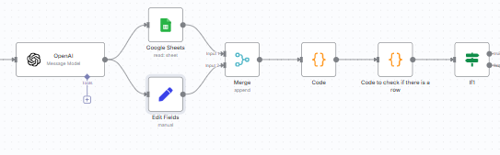
Here is How to Resolve the Problem
Create an Edit node that gets the data from the Open AI Node
Add a Merge node that will combine the data from the Google Sheet node and the Edit node.
Add a code node to determine which value to take when it exists in both nodes. Get the code from ChatGPT or in my speaker notes. Make sure the variable names matches your input.
Add a code node to check if there is a row.
Notes:
Here is the code for the first Code node:
// Get the first input item
const input = $input.first().json;;
// Try to safely extract the data
const email = $('Awaiting input from the form').first().json.Email||$('Google Sheets').first().json.email || "";
// DEBUG: Log input keys to help troubleshoot
console.log("Incoming keys:", Object.keys(input));
// These are the keys we expect in a matched Google Sheet row
const expectedKeys = [ 'Email', ]; // <-- Make sure these match exactly
// Check if any of these keys are present in the incoming input
const rowFound = expectedKeys.some(key => Object.prototype.hasOwnProperty.call(input, key));
const cityOf =$('Awaiting input from the form').first().json.City
const returnMessage =$('OpenAI').first().json.message.content
// Return output
return [{
json: {
email,
cityOf,
returnMessage,
rowFound,
rowData: rowFound ? input : {}
Here is the code for the second Code node:
const rows = $items("Google Sheets"); // Replace with the exact name of your Google Sheets node
if (rows.length === 0 || !rows[0].json || Object.keys(rows[0].json).length === 0) {
return [
{
json: {
found: false,
message: "No row found.",
},
},
];
} else {
return [
{
json: {
found: true,
message: "Row found.",
data: rows[0].json,
},
},
];

Slide 6
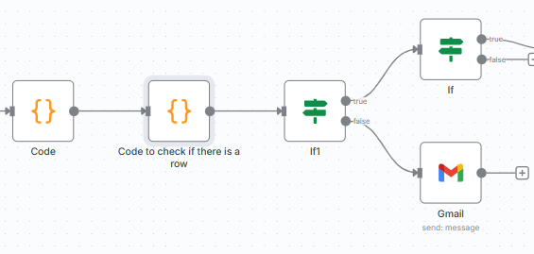
Go Back to Your If node
Use the input from the two Code node to make the If node work.
If it finds a row proceed to the next node
If it doesn’t find a row, send an email to the client advising them that this is not the email used during registration. Get ChatGPT to draft the email.

Slide 7
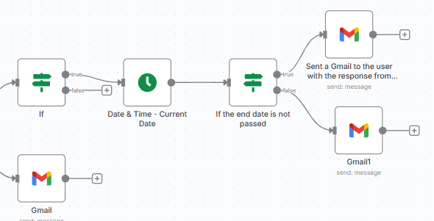
If there if a Row Found
Use a Date & Time node to determine the current date
Use an If node to determine if the End Date is not passed
Send 2 emails accordingly. Get ChatGPT to draft the emails

Slide 8

Test – Test - Test
Don’t forget to activate the workflow
Test by submitting a new form
Test by buying each product in WordPress.
Note: You may need to delete the rows in the spreadsheet created for testing and / or to change the end date in the spreadsheet

Slide 9


