Slide 1

Master n8n and WordPress Integration
Module3 - n8n Advanced (Monitor Sales)

Slide 2
Course Content
Week | Content | Activities
Week 1 | Course Outline Module 1: WordPress (Create a Business Site) | Hands-on Exercises Open discussion
Week 2 | Module 2: Introduction to n8n (Create the Products) | Hands-on Exercises Open discussion
Week 3 | Module 3 n8n – Advanced (Monitor Sales) | Hands-on Exercises Open discussion
Weed 4 | Module 4 8n8 – Fix Bugs / Maintenance (Improve the Products) | Hands-on Exercises Open discussion
Week 5 | Module 5 Creating a Video (Marketing Campaign) Module 6 Overview and Conclusion | Hands-on Exercises Open discussion

Slide 3

Agenda
Set Up the Trigger: WooCommerce Plugin
Determine Which Product Was Purchased
Find or Create a Row in the Google Sheet
Calculate the End Date
Determine if it is a new client or an existing client
If it is an existing client, check if the 7-day trial is over
Take action to create the new client or respond to an existing client

Slide 4

Create a New Workflow
Name it: AI Newsfeed - Monitor Sales

Slide 5
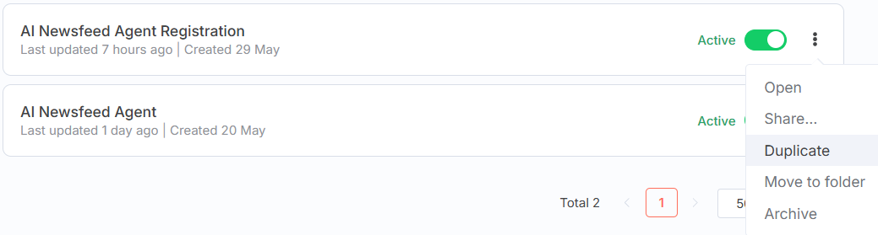
Tips
Use the CTR key and the mouse to move the Workflow in n8n
You can add some Sticky Notes to organize your workflow. Search for it by clicking the +
You can duplicate a node within a workflow or copy one or more nodes to a new workflow.
Use the same URL for multiple registration workflows
You can duplicate the entire Workflow, so you don’t start from scratch to create a registration module for a new product. Make sure to change all the field mapping and especially the Google Sheet name.

Slide 6
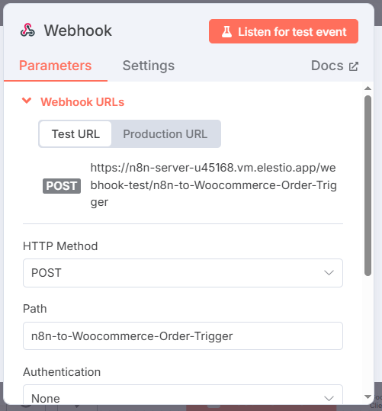
Set up the Trigger
1. Set Up the Trigger: Webhook
2. The HTTP method is POST
3. Copy the test URL
4. In the WordPress Dashboard, go to the WooCommerce - Settings – Advanced – Webhoocks.
5. Add a new Webhook and name it “n8n Order Trigger for Registration”.
6. Paste the test URL to the Delivery URL (CTRL + V)

Slide 7
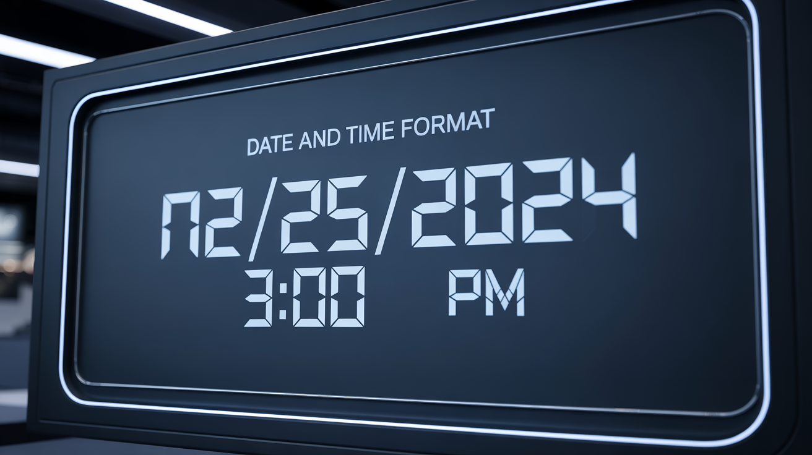
Purchase the Free Product
1. You must purchase one of your products to test the Trigger and pull sample purchase data (You will receive information like product name, email, phone number, and purchase date)
2. Test the n8n Workflow. There may be a delay before the Webhook gets the transaction. If the test times out. Start it again immediately.
3. Once you receive the data in the n8n trigger, use the pin ( in the upper right corner of the output) to keep the data for further testing

Slide 8
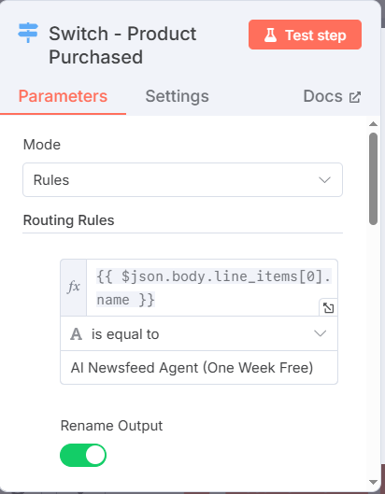
Determine Which Product Was Purchased
4. Add a Switch: To Determine Which Product Was Purchased
Add two routing rules and rename the outputs
Routing Rule 1
  Sales Product Name
  Is equal to
  Name of the 1st product in WordPress
Routing Rule 2
  Sales Product Name
  Is equal to
  name of the 2nd product in WordPress

Slide 9
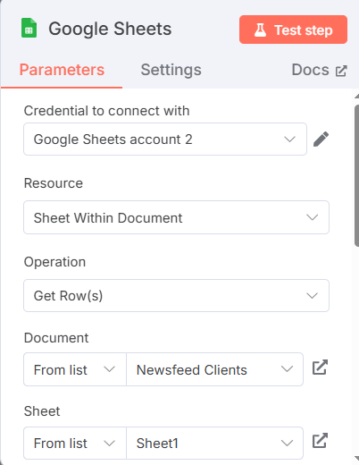
Branch 1 – Free Trial
Add a Google Sheet node to see if there is a row with the email.
Drag the email name from the input from the trigger node

Slide 10
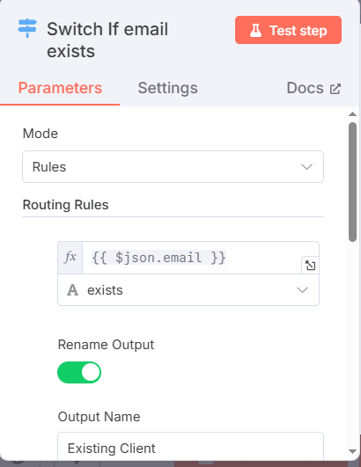
Add a Switch Node
7. If the worksheet finds a row with the email, it is an existing client
8. If there is no row with the email, it is a new client

Slide 11
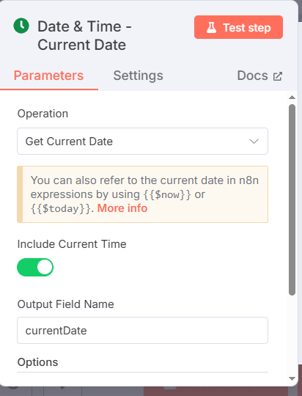
Add a Date and Time Node
9. Determine the current date and time
Note: You could put this node before the Switch node to avoid having 2 of them

Slide 12
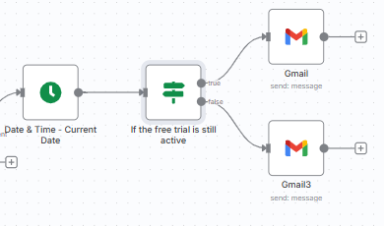
Add an IF node
10. Determine if the 7-day trial is over by comparing the end date with the current date
11. Then add 2 email nodes to advise the clients accordingly
If it is someone who tries to register for a second free trial, redirect them to the subscription product URL
Use ChatGPT to write the emails

Slide 13
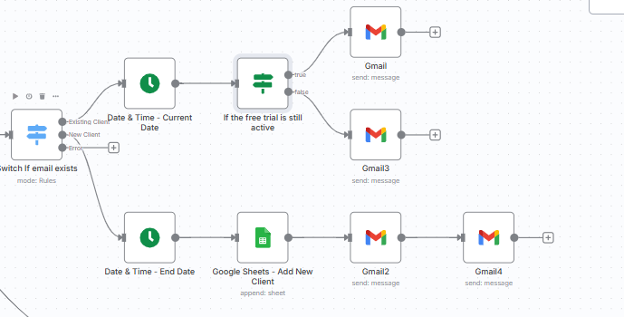
Go Back to the Switch

Slide 14
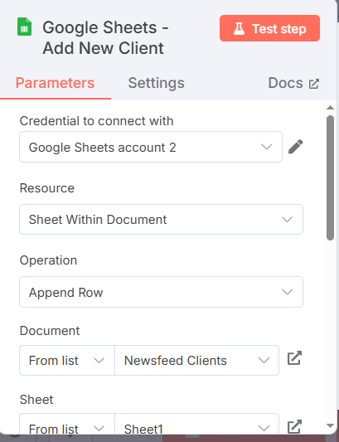
Create The New Client Branch
12.Put your mouse over the Date and Time node and click on the …
Click on Duplicate
Attach the duplicated node to the New Client branch
Add a Google Sheet node to append a row to add the information for the new client email
  - Emaill
  - End Date
Send a welcome email to the client with the URL to the product workflow. It is in the Trigger node of the product workflow.
Send an email to yourself to advise you that you have a new client

Slide 15
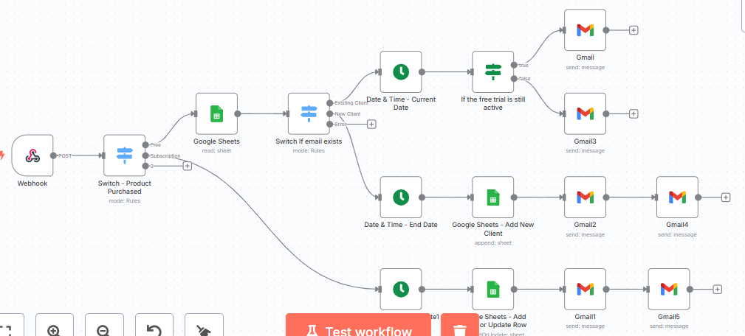
Go Back to the First Switch

Slide 16
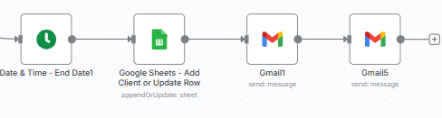
Create the Subscription Branch
17. Duplicate the Date & Time node again
18. Add a Google Sheet node to Append (if it is a free trial client) or Create a new row (if it is a new client)
19. Send a welcome email to the client with the URL to the product workflow. It is in the Trigger node of the product workflow
20. Send yourself an email to say you have a new client

Slide 17
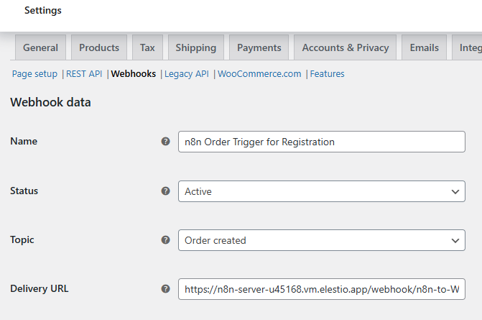
Test – Test - Test
21. Activate your workflow
22. Once you are done testing, don’t forget to copy the Production URL to the WooCommerce Webhook
23. Test by buying each product

Slide 18
Pitfalls
You need to set up the WordPress site ahead of time, as it takes 24 hours for your new URL become active.
Sometimes there is a long delay before the n8n Webhook trigger capture the WooCommerce transaction.
Data input errors: Wrong email or email entered with typo results in no action. You need to send an email to advise the user.
The Get Row node does not return a False or the data if it doesn’t find a row
When you use ChatGPT to create an outline, you need to specify that you want to use free tools
When you get JSON code from ChatGPT change the variables to the ones in your input.

Slide 19
Tips
Use the CTR key and the mouse to move the Workflow in n8n
You can add some Sticky Notes to organize your workflow. Search for it by clicking the +
You can duplicate a node within a workflow or copy one or more nodes to a new workflow.
Use the same URL for multiple registration workflows
You can duplicate the entire Workflow, so you don’t start from scratch to create a registration module for a new product. Make sure to change all the field mapping and especially the Google Sheet name.

Slide 20
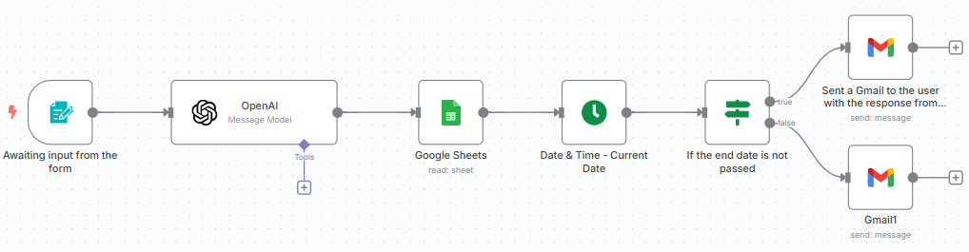
Next Module
We will update the product workflow to check if a the registration is expired

Slide 21


