Slide 1

Master n8n and WordPress Integration
Module 2 - Introduction to n8n – Creating the Product

Slide 2
Course Content
Week | Content | Activities
Week 1 | Course Outline Module 1: WordPress (Create a Business Site) | Hands-on Exercises Open discussion
Week 2 | Module 2: Introduction to n8n (Create the Products) | Hands-on Exercises Open discussion
Week 3 | Module 3 n8n – Advanced (Monitor Sales) | Hands-on Exercises Open discussion
Weed 4 | Module 4 8n8 – Fix Bugs / Maintenance (Improve the Products) | Hands-on Exercises Open discussion
Week 5 | Module 5 Creating a Video (Marketing Campaign) Module 6 Overview and Conclusion | Hands-on Exercises Open discussion

Slide 3

Agenda
Create Directories in Gmail Drive
Create a Google Sheet
Set up n8n to Retrieve Data From the Sheet and Send an Email

Slide 4

Create a Folder in Your Google Drive
1. Open Google Drive
Go to drive.google.com.
2. Create the Main Folder ("AI")
Click the "+ New" button (on the left-hand side).
Select "Folder" from the menu.
Name the folder AI and click Create.
This is your main folder where everything related to your AI projects will go.

Slide 5
Create a Subfolder for Your Project
3. Create a Subfolder (“AI Newsfeed Agent")
Open the AI folder by double-clicking it.
Inside the AI folder:
  Click "+ New" again.
  Select "Folder".
  Name this new folder AI Newsfeed Agent and click Create.
This organizes your first AI project neatly under the AI main folder.

Slide 6
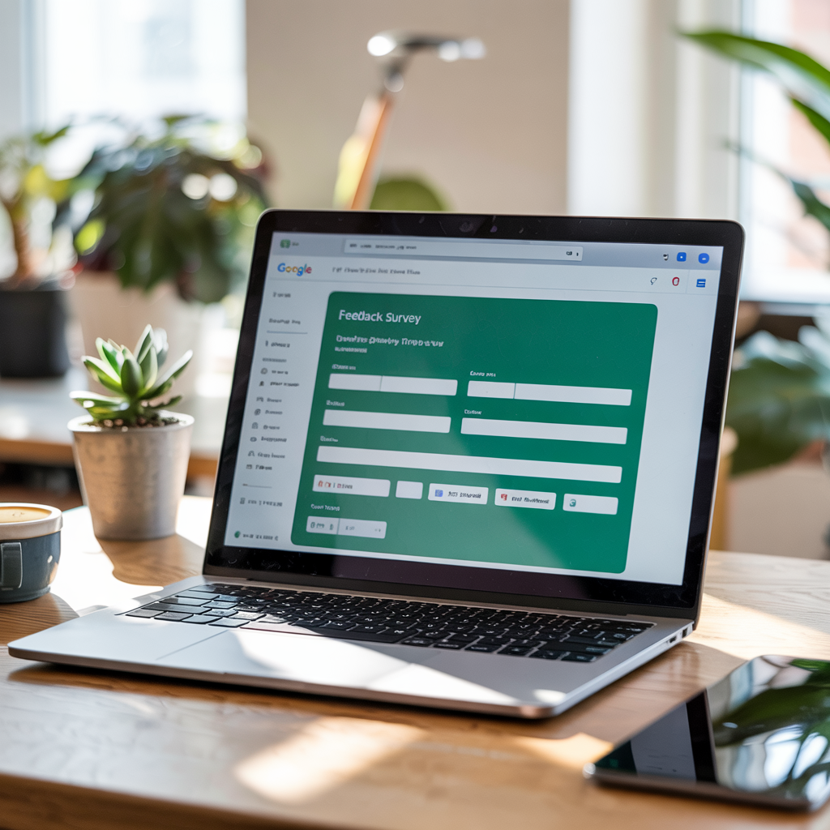
Create a Google Sheet
1. Open Google Drive
Go to drive.google.com.
2. Go to Your “AI Newsfeed Agent" Folder
You’ll create and save your Google Sheet inside this folder!

Slide 7
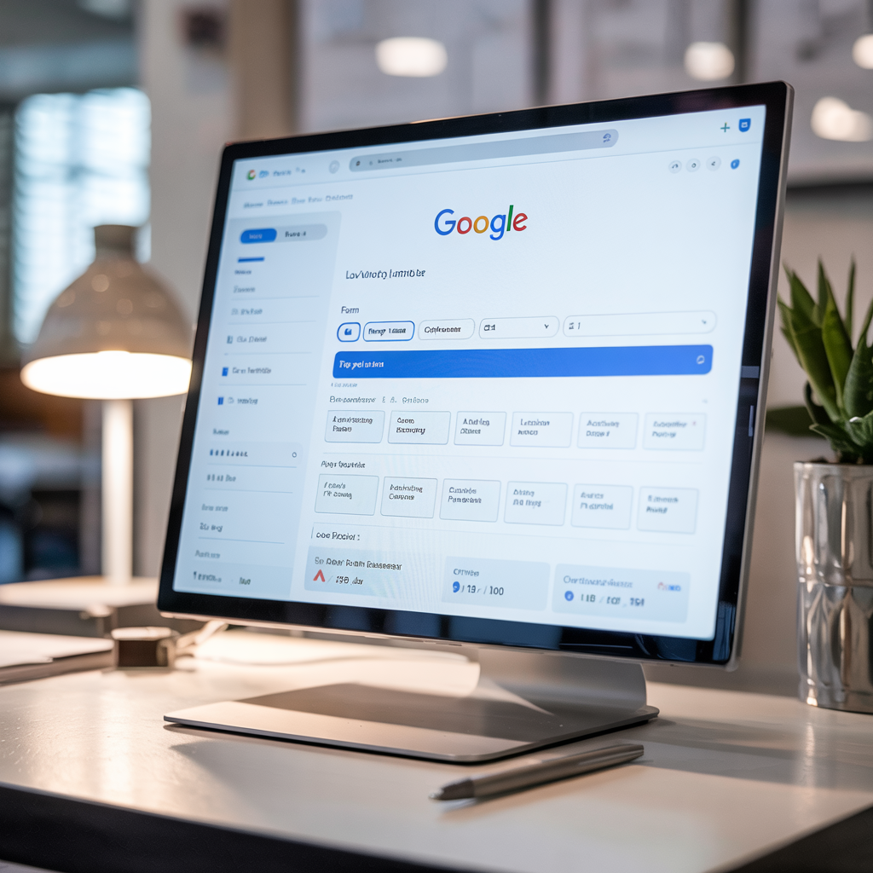
Create the Google Sheet
3. Create Your Google Sheet
Inside the AI Newsfeed Agent folder:
  Click the "+ New" button (top-left corner).
  Hover over "More" and select "Google Sheet".
This ensures the Google Sheet is saved inside the AI Newsfeed Agent folder automatically.

Slide 8

Instructions to Set up n8n
Go to the Elestio Website https://elest.io/
Start free or create an account
Select the cloud provider HETZNER
Select n8n
Name your server
Go to the Admin UI to open n8n. You may need to click on the show admin Ui BUTTON

Slide 9
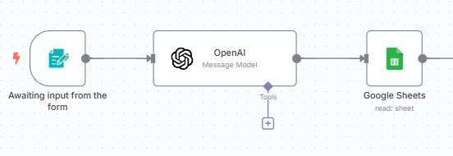
Understanding the n8n Basics
2. Understand the Basics
The sidebar menu
Creating a workflow
Creating a folder (AI Newsfeed Agent)
Each workflow has:
  One or more trigger node(s) (what starts the automation)
  One or more nodes (what happens next)

Slide 10
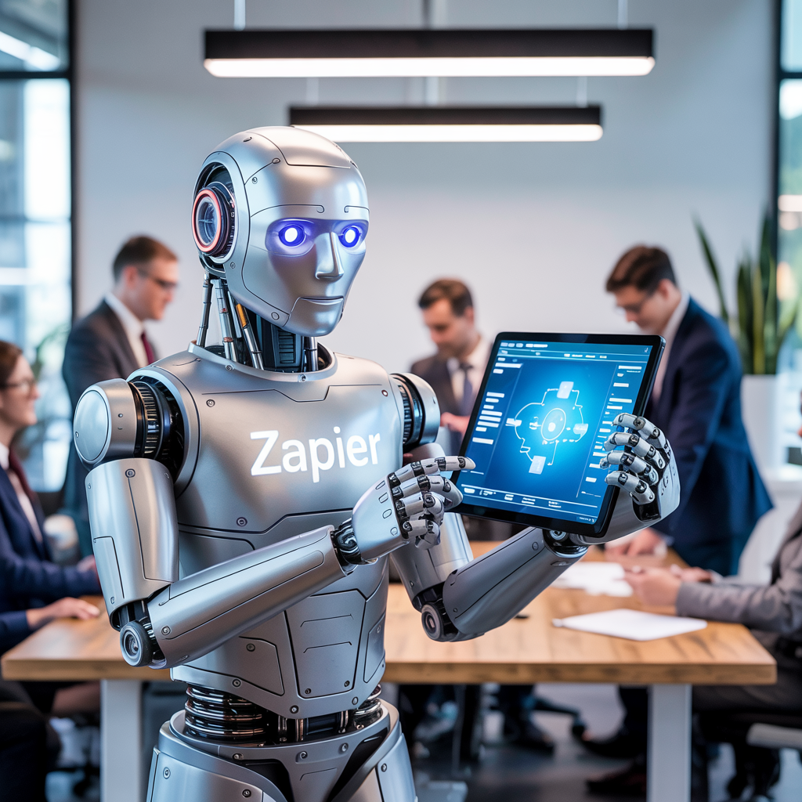
Create Your First Workflow
4. Create Your First Workflow
Change the name to AI Newsfeed Agent
Click on the AI Newsfeed Agent folder
Click the + button
Choose your Trigger: N8n forms
  Add questions
    First Name:
    Last Name:
    Email:
    City:

Slide 11
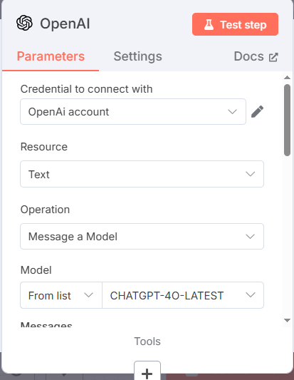


Add Nodes
5. Click of the +
Set Up an OpenAI node
You will need to go to the OpenAI website to create an account (click on Docs to get instructions)
Scroll Down and Add the prompt (see my next page)

Slide 12
Add a Prompt
Expand the prompt by clicking on the small icon in the buttom right corner
Prompt:
  Provide a short news feed summary (around 5 headlines and 1–2 sentences each) about the latest local news happening on {{ $json.submittedAt }} in {{ $json.City }}. Focus on important events, major announcements, and community news. Do not include the weather forecast. Keep it concise and up-to-date.
Replace the {{ $json.submittedAt }} in {{ $json.City }}. Drag the fields from the input at the left
Activate the simplify output
Notes:
Provide a short news feed summary (around 5 headlines and 1–2 sentences each) about the latest local news happening on {{ $json.submittedAt }} in {{ $json.City }}. Focus on important events, major announcements, and community news. Do not include the weather forecast. Keep it concise and up-to-date.

Slide 13
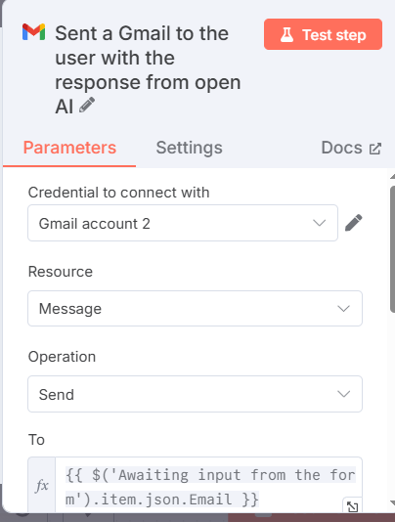
Create the Next Node
    6. Node: Gmail
    You will need to create the credentials to link to Gmail. Click on Docs for instructions

Slide 14
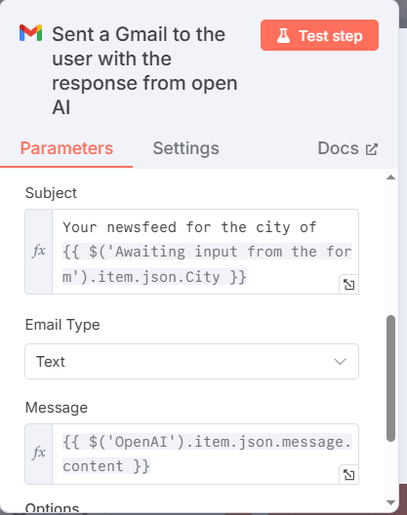
Gmail Node (Continued)
Scroll Down and add the subject and message by dragging the appropriate field from the right
You can test each node individually or the entire workflow.
Double-click on the trigger to obtain the URL to test it in your browser. Use the production URL, not the test one.
In the next module, I will show you how to send the URL to the client when they purchase the product.

Slide 15
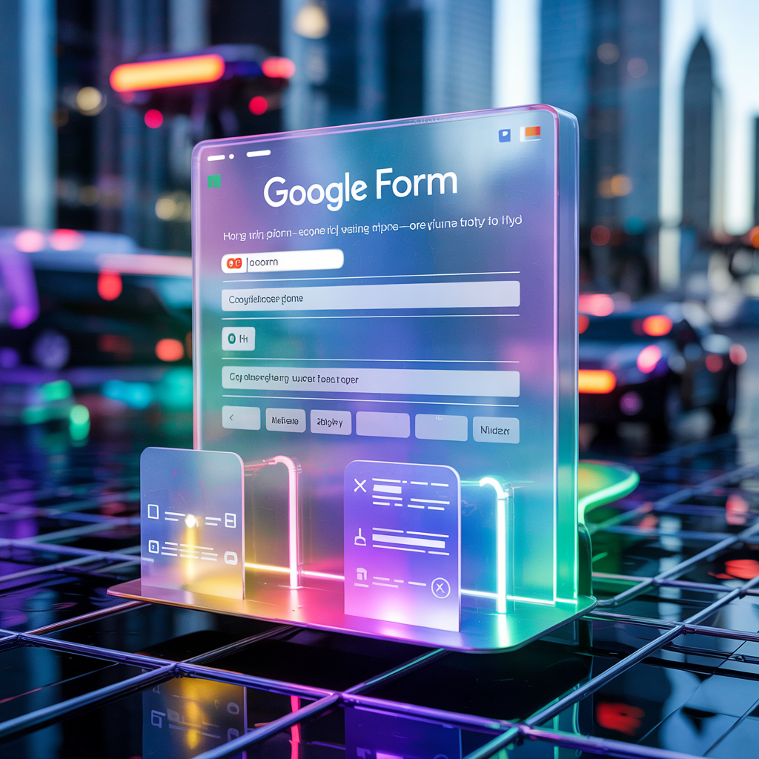
Test – Test - Test
8. Test Your Wokflow
Check if the action works properly (Did you get the email, and did it contain the ChatGPT information)

Slide 16
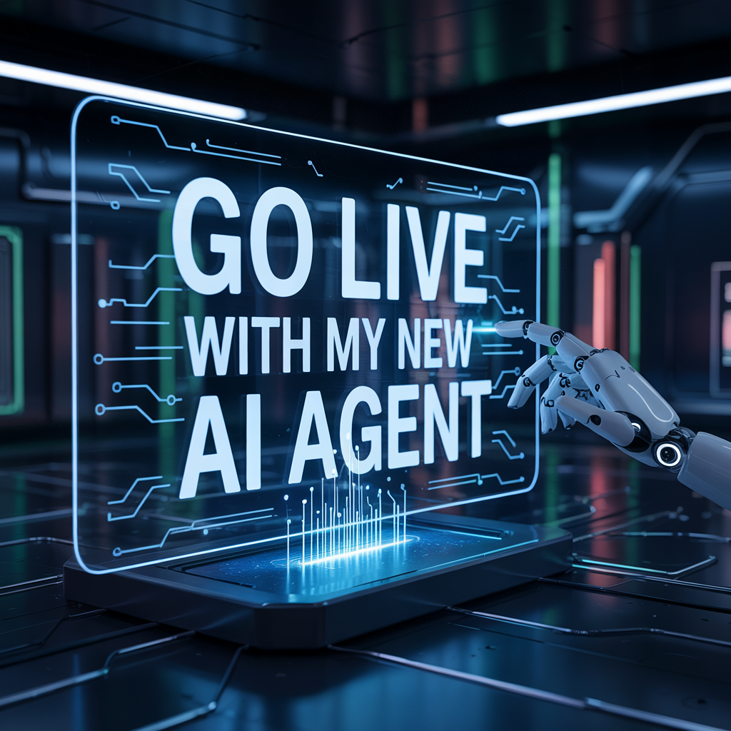
Go Live
9. Turn your workflow on
After a successful test, click “Active."
Your automation is now live!
Test sending a response directly from the URL

Slide 17
Next Module
Show the students what the two workflows will look like at the end of module 3 and 4

Slide 18


