Slide 1

Master n8n and WordPress Integration
Module 1 – WordPress
Creating a Business Site

Slide 2
Course Content
Week | Content | Activities
Week 1 | Course Outline Module 1: WordPress (Create a Business Site) | Hands-on Exercises Open discussion
Week 2 | Module 2: Introduction to n8n (Create the Products) | Hands-on Exercises Open discussion
Week 3 | Module 3 n8n – Advanced (Monitor Sales) | Hands-on Exercises Open discussion
Weed 4 | Module 4 8n8 – Fix Bugs / Maintenance (Improve the Products) | Hands-on Exercises Open discussion
Week 5 | Module 5 Creating a Video (Marketing Campaign) Module 6 Overview and Conclusion | Hands-on Exercises Open discussion

Slide 3

Agenda
Create a New Google Account
Set up WordPress
Create a Website with WordPress
Create 2 Products (A Free Version and a Subscription Version)
Get Help from chatGpt for Product Description
Set-up Stripe with WooCommerce
Set-up HST in WooCommerce

Slide 4

To Create a Google Account
Navigate to Google's account creation page, select the account type (personal, work, or child), enter your name, desired username (email address), and a strong password. You'll then be prompted to add your birthday, gender, and phone number for account recovery and personalization preferences. Finally, agree to the terms of service and privacy policy.

Slide 5





Setting-up WordPress
Create an account with a provider such as Westinger or Bluehost.
  Create a URL (Note: You need to wait 24 hours before your new URL is active)
Intall WordPress
Install the WooCommerce plugin
Create two products in WordPress
  One for the Free one-week trial (Call the product “AI Newsfeed Agent – Free Trial”)
  One to the Subscription ($ 50 for one year) (Call the product “AI Newsfeed Agent – Subscription”)
Create a Main page and set it as the Home page. See my site WWW.AIandAutomationTools.com
Your products are automatically added at the bottom of the home page.

Slide 6
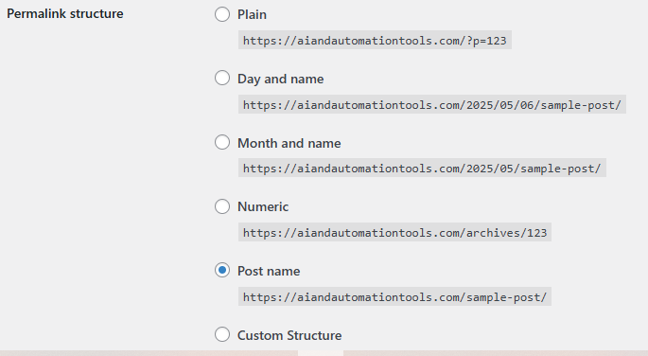
WordPress Permalink
In the WordPress Dashboard go to the setings – permalink and change the setting to Post name.

Slide 7
Enable Stripe in WooCommerce
1. Go to WooCommerce > Settings > Payments.
Find Stripe – Credit Card / Debit Card (Stripe) and click Enable.
Then click Manage to configure the Stripe settings.
2. Get Your Stripe API Keys
Log in to your Stripe Dashboard.
Go to Developers > API keys.
Copy your Publishable key and Secret key (test keys for testing, live keys for production).
3. Configure Stripe in WooCommerce
In the Stripe settings page in WooCommerce, paste your Publishable Key and Secret Key.

Slide 8
To Set-Up Your Bank Account in Stripe
Step 1: Log in to Stripe
Go to https://dashboard.stripe.com and sign in to your account
Step 2: Go to Settings
Step 3: Add or Edit Bank Account
Step 4: Enter Bank Account Details
Step 5: Verify the Account (if required)
✅ Step 6: Set Payout Schedule (Optional)

Slide 9
Set-up HST in WooCommerce
Step 1: Enable Taxes in WooCommerce
Go to your WordPress Dashboard.
Navigate to WooCommerce > Settings.
Under the General tab:
  Check the box: ✅ Enable taxes and tax calculations.
  Scroll down and click Save changes.

Slide 10
Set-up HST in WooCommerce (continued)
Step 2: Configure Tax Options
Go to WooCommerce > Settings > Tax (this tab appears only after enabling taxes).
Under Tax Options, set the following:
  Prices entered with tax: Choose whether your prices include tax (usually No).
  Calculate tax based on: Usually set to Customer shipping address.
  Shipping tax class: Set to Based on cart items.
  Save changes.

Slide 11
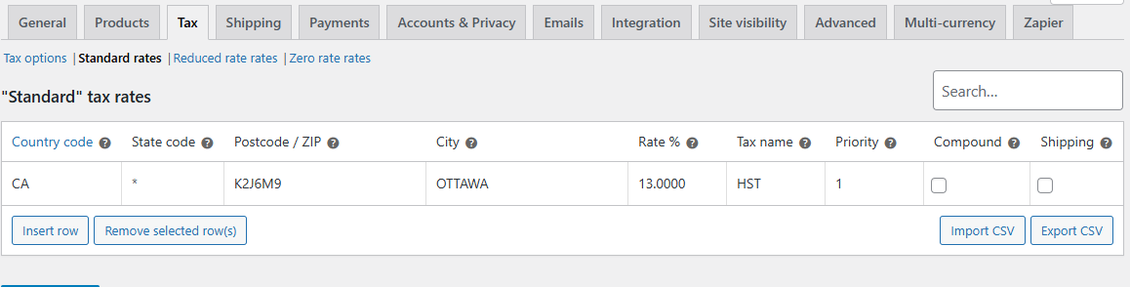
Set-up HST in WooCommerce (continued)
Step 3: Set Up Canadian HST Tax Rates
Under the Tax tab, click on Standard rates.
Click Insert row, then enter the following details:
  Country code: CA
  State code: The 2-letter province code (e.g., ON for Ontario)
  Rate %: The total HST rate for the province (13 % for Ontario)
  Tax name: e.g., HST
  Priority: 1
  Compound: Leave unchecked
  Shipping: Check if HST applies to shipping (usually yes)

Slide 12


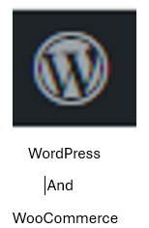





Integration
Overview
Gmail
Forms
Google
Sheets

Slide 13


