Slide 1
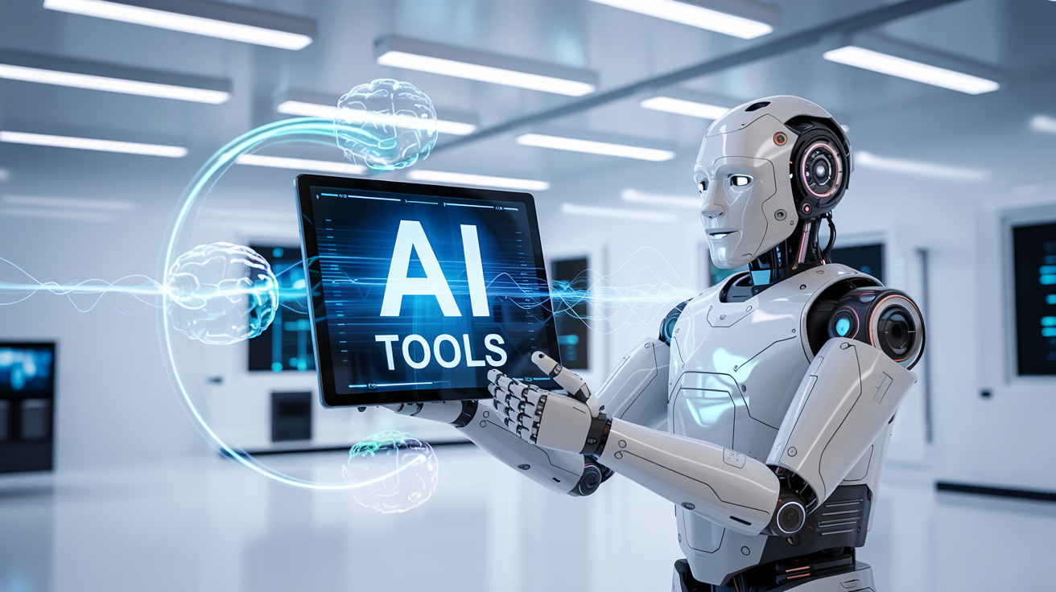
Master n8n and WordPress Integration
Course Logistics

Slide 2




Introduction
Hi! My name is Yvon Parizeau and I am your course professor.

Slide 3

Introductions
Introductions
  Name
  Experience
  Your expectation for this course
Poll Questions

Slide 4

Agenda
Introductions
Course Overview
Logistics
Communications
Course Content
AI Tools

Slide 5
Course Overview
Unlock the power of AI with our comprehensive course, Master n8n and Wordpress integration. In this course, you’ll learn to harness essential tools like WordPress, n8n, ChatGPT, and more to elevate your projects and simplify your workflows.

Slide 6

Logistics
All classes will be recorded
The course uses Zoom – Limit of 100 people
The exact time and dates will be booked in Zoom

Slide 7

Communication
E-mail: AIandAutomationTools@gmail.com

Slide 8
Tools
WordPress
n8n
Gmail account
chatGpt
invideo
YouTube Channel

Slide 9
Course Content
Week | Content | Activities
Week 1 | Course Outline Module 1: WordPress (Create a Business Site) | Hands-on Exercises Open discussion
Week 2 | Module 2: Introduction to n8n (Create the Products) | Hands-on Exercises Open discussion
Week 3 | Module 3 n8n – Advanced (Monitor Sales) | Hands-on Exercises Open discussion
Weed 4 | Module 4 8n8 – Fix Bugs / Maintenance (Improve the Products) | Hands-on Exercises Open discussion
Week 5 | Module 5 Creating a Video (Marketing Campaign) Module 6 Overview and Conclusion | Hands-on Exercises Open discussion

Slide 10

Breakout Rooms – 15 Minutes
Discuss your expectation for this course
Choose a speaker to represent your room
Return to the class with a list of the 3 to 5 main expectations from your room

Slide 11


